Slide 1

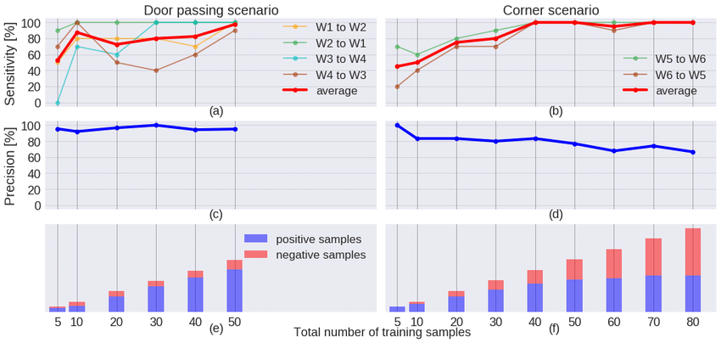

Classifier Evaluation
John Abela
Department of CIS
Faculty of ICT
University of Malta
john.abela@um.edu.mt
+ 365 79367936
Room 1A/27
FICT Building
©John Abela
Faculty of
ICT
Department of
Computer Information Systems
Last Updated
27-Oct-2022

Slide 2
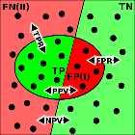
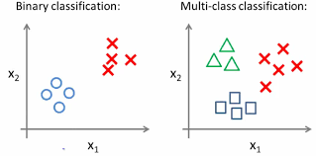
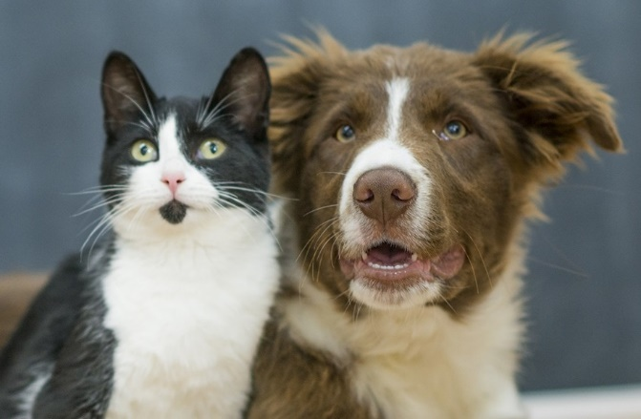

Classifier Evaluation
Classifier
Evaluation
It is usually prudent, and advised, that a classification algorithm (binary or multi-class) is evaluated.
This applies to all classification algorithms – whether learning (supervised or unsupervised), based on meta-heuristics, or some other.
The purpose of evaluation is to determine how well the classification algorithm performs on some test data.
Suppose we have a classifier that was trained (or programmed) to distinguish between pictures of cats and dogs.
ICT

Slide 3
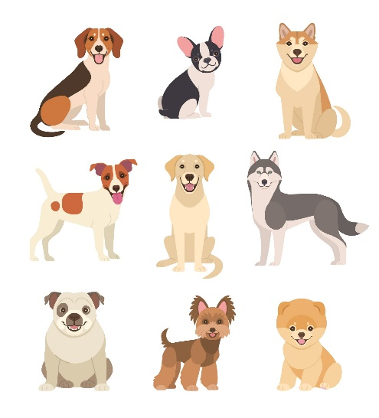
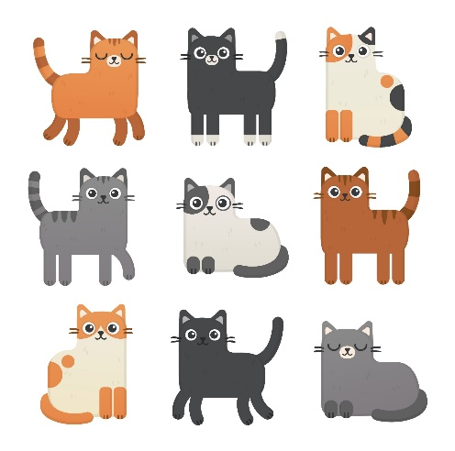
Classifier Evaluation using Test Data
Classifier
Evaluation
The objective here is to evaluate how the classifier performs on our test data.
It is common practice to use around 80% of the available data for training and the remaining 20% for evaluation (validation).
Some algorithms also continuously use test data during training.
Our test dataset consists of 9 dogs and 9 cats.
Each datum is labelled as either a cat or dog.
The test dataset is input to the classifier (without the labels) and the output of the classifier is recorded in a table.
Dog
Dog
Dog
Dog
Dog
Dog
Dog
Dog
Dog
Cat
Cat
Cat
Cat
Cat
Cat
Cat
Cat
Cat
ICT

Slide 4


Classifier Evaluation using Test Data
ID | Actual | Predicted
1 | Dog | Dog
2 | Dog | Dog
3 | Dog | Cat
4 | Dog | Dog
5 | Dog | Dog
6 | Dog | Cat
7 | Dog | Dog
8 | Dog | Dog
9 | Dog | Dog
10 | Cat | Cat
11 | Cat | Dog
12 | Cat | Cat
13 | Cat | Dog
14 | Cat | Cat
15 | Cat | Cat
16 | Cat | Cat
17 | Cat | Dog
18 | Cat | Cat
The results from the classifier are recorded in the table on the right.
The classifier:
Misclassified 2 dogs as cats.
Misclassified 3 cats as dogs.
Most dogs would be very insulted if they were classified as cats.
We use a confusion matrix to summarize the results.
A confusion matrix is a technique used to summarize the performance of a classifier.
≠
ICT

Slide 5
Classifier Evaluation using Test Data
ID | Actual | Predicted
1 | Dog | Dog
2 | Dog | Dog
3 | Dog | Cat
4 | Dog | Dog
5 | Dog | Dog
6 | Dog | Cat
7 | Dog | Dog
8 | Dog | Dog
9 | Dog | Dog
10 | Cat | Cat
11 | Cat | Dog
12 | Cat | Cat
13 | Cat | Dog
14 | Cat | Cat
15 | Cat | Cat
16 | Cat | Cat
17 | Cat | Dog
18 | Cat | Cat
Dogs classified as Dogs: 7
Dogs classified as Cats: 2
Cats classified as Cats: 6
Cats classified as Dogs: 3
Accuracy is: total correct predictions / total predictions (TP_{Dog} + TP_{Cat})/18 = (7+6)/18 = 72%
 |  | Predicted
 |  | Dog | Cat
Actual | Dog | 7 | 2 | 9
 | Cat | 3 | 6 | 9
 |  | 10 | 8
ICT

Slide 6
Classifier Evaluation using Test Data
ID | Actual | Predicted
1 | Dog | Dog
2 | Dog | Dog
3 | Dog | Cat
4 | Dog | Dog
5 | Dog | Dog
6 | Dog | Cat
7 | Dog | Dog
8 | Dog | Dog
9 | Dog | Dog
10 | Cat | Cat
11 | Cat | Dog
12 | Cat | Cat
13 | Cat | Dog
14 | Cat | Cat
15 | Cat | Cat
16 | Cat | Cat
17 | Cat | Dog
18 | Cat | Cat
Dogs classified as Dogs: 7 (T_{Dogs})
Dogs classified as Cats: 2 (F_{Cats})
Cats classified as Cats: 6 (T_{Cats})
Cats classified as Dogs: 3 (F_{Dogs})
 |  | Predicted
 |  | Dog | Cat
Actual | Dog | 7 | 2 | 9
 | Cat | 3 | 6 | 9
 |  | 10 | 8
ICT

Slide 7
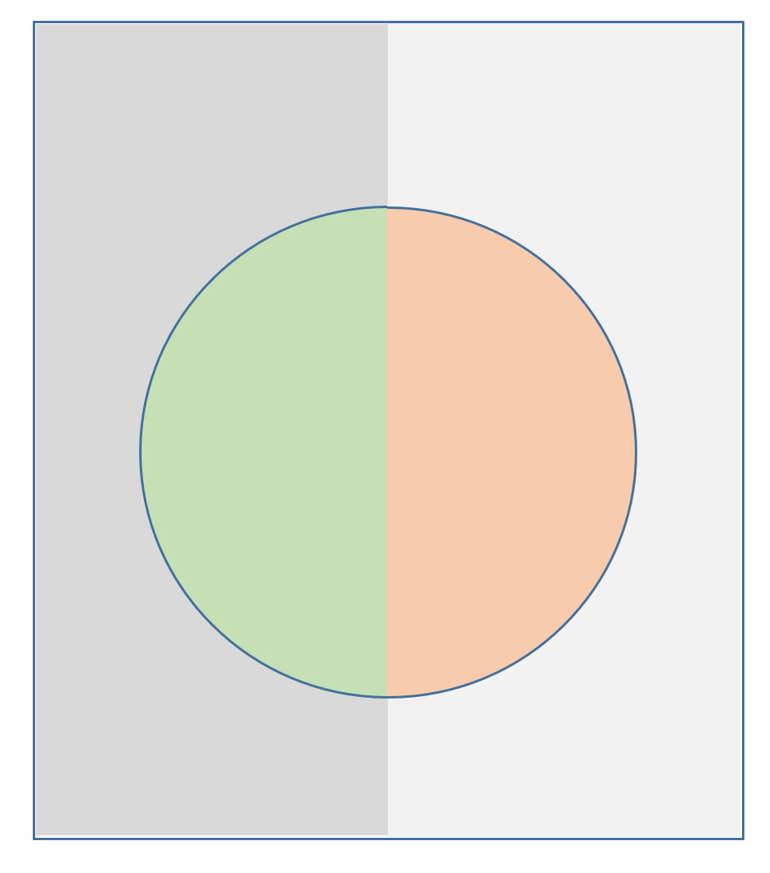


Classifier Evaluation using Test Data
Actual positives
Actual negatives
Suppose that instead of Dogs and Cats (Multi-class) we have Binary classification. In other words items either belong to one main class or not at all.
Dogs or Non-Dogs, or:
Dogs (Positive) and Non-Dogs (Negative).
This representation is very popular.
false negatives
true negatives
 |  | Predicted
 |  | Dog Positives | Cat Negatives
Actual | Dog Positives | 7 | 2 | 9
 | Cat Negatives | 3 | 6 | 9
 |  | 10 | 8
true positives
false positives
TP
FN
FP
TN
ICT

Slide 8
Binary Classifier Evaluation
ID | Actual | Predicted
1 | Dog | Dog
2 | Dog | Dog
3 | Dog | Cat
4 | Dog | Dog
5 | Dog | Dog
6 | Dog | Cat
7 | Dog | Dog
8 | Dog | Dog
9 | Dog | Dog
10 | Cat | Cat
11 | Cat | Dog
12 | Cat | Cat
13 | Cat | Dog
14 | Cat | Cat
15 | Cat | Cat
16 | Cat | Cat
17 | Cat | Dog
18 | Cat | Cat
True Positives (TP): True positives are the cases when the actual class of the data point was True and the predicted is also True.
True Negatives (TN): True negatives are the cases when the actual class of the data point was False and the predicted is also False.
False Positives (FP): False positives are the cases when the actual class of the data point was False and the predicted is True.
False Negatives (FN): False negatives are the cases when the actual class of the data point was True and the predicted is False.
ICT

Slide 9
Binary Classifier Evaluation
ID | Actual | Predicted
1 | Dog | Dog
2 | Dog | Dog
3 | Dog | Cat
4 | Dog | Dog
5 | Dog | Dog
6 | Dog | Cat
7 | Dog | Dog
8 | Dog | Dog
9 | Dog | Dog
10 | Cat | Cat
11 | Cat | Dog
12 | Cat | Cat
13 | Cat | Dog
14 | Cat | Cat
15 | Cat | Cat
16 | Cat | Cat
17 | Cat | Dog
18 | Cat | Cat
TP - Dogs (P) classified as Dogs (P): 7
FN - Dogs (P) classified as Non-dogs (N): 2
TN – Non-dogs (N) classified as Non-dogs (N): 6
FP – Non-dogs (N) classified as Dogs (P): 3
TP + FN total number of actual dogs.
FP + TN total number of actual non-dogs.
 |  | Predicted
 |  | Dog | Cat
Actual | Dog | TP 7 | FN 2
 | Cat | FP 3 | TN 6
 |  | 9
ICT

Slide 10
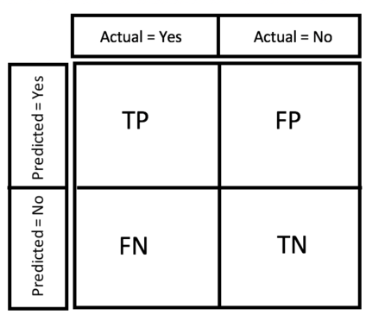
Binary Classifier Evaluation Metrics
Classifier
Evaluation
Recall or Sensitivity or TPR (True Positive Rate): Number of items correctly identified as positive out of total actual positives: TP/(TP+FN)
Specificity or TNR (True Negative Rate): Number of items correctly identified as negative out of total actual negatives: TN/(FP+TN)
Precision: Number of items correctly identified as positive out of total items identified as positive: TP/(TP+FP)
False Positive Rate or Type I Error: Number of items wrongly identified as positive out of total actual negatives: FP/(FP+TN)
False Negative Rate or Type II Error: Number of items wrongly identified as negative out of total actual positives: FN/(TP+FN)
ICT

Slide 11
Binary Classifier Evaluation Metrics
Classifier
Evaluation
F1 Score: It is a harmonic mean of precision and recall given by: F1 = 2*Precision*Recall/(Precision + Recall)
Accuracy: Percentage of total items classified correctly: (TP+TN)/(N+P)
ICT

Slide 12

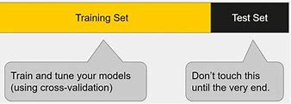
K-Fold Cross Validation
Classifier
Evaluation
Very often the test data is either not available or cannot be used.
How does one choose the learning parameters?
The solution is to divide the training data (randomly) in folds and then use leave-one-out training.
You then average the results over all folds and choose the best parameters.
The is called model selection.
ICT

